Slide 1

Marketing Campaign: AI Promoting Nuclear Power
By: Khris-Dylan Gainza, Neveah Charles, Liam Resier, and Tyrese Nord

Slide 2
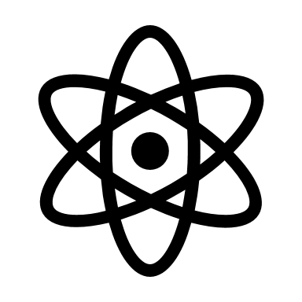
Outline
Background
Information
Concerns
Benefits
Charts/Graphs
Idea and scenario
Impact and scalability

Slide 3
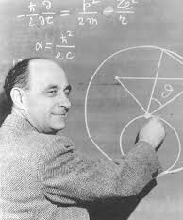
Background
History
Early Developments: concept - mid-20th century, first experimental nuclear reactor – 1942 (When Enrico Fermi led a group of scientists). The Experimental Breeder Reactor-1 (EBR-1) was the first reactor to generate electricity from nuclear energy.
Commercialization: The Shipping port Atomic Power Station, in 1957.
Global Expansion: rapid expansion in the 1960s and 1970s, many countries adopting nuclear energy

Slide 4
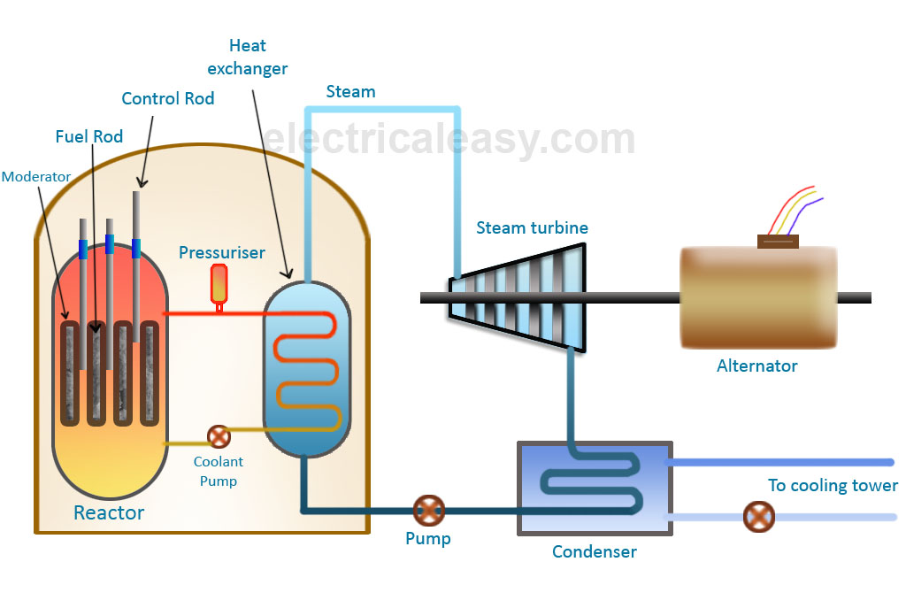
Information
How nuclear energy works:
In a standard fission reactor, a fuel is used (usually uranium) to boil a vast amount of water and the steam made pushes a turbine which harvests the energy.

Slide 5
Concerns
Safety
People like to use accidents like Fukishima to justify opposition toward nuclear power, however nuclear accidents are usually caused by human error or natural disasters.
Cost
Nuclear power does cost more than other power sources to initially start, however it is cheaper in the long run and lasts a long time.

Slide 6
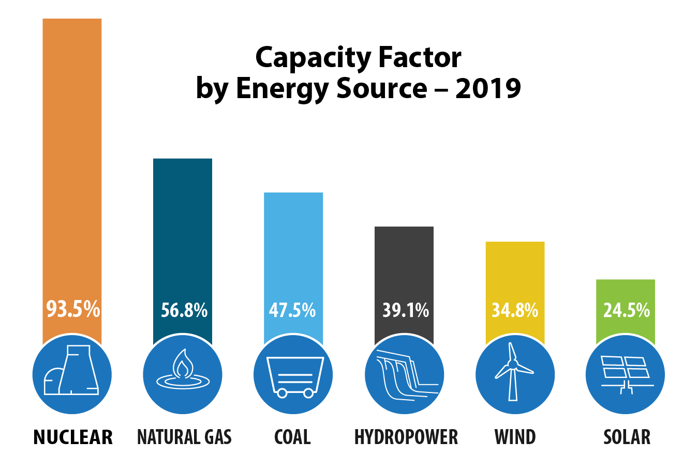

Benefits
Low Green House Gas Emissions
High Energy Density
Low operating costs
Safe power source
Long-Term Energy Solution

Slide 7
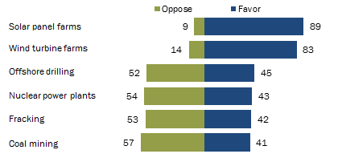
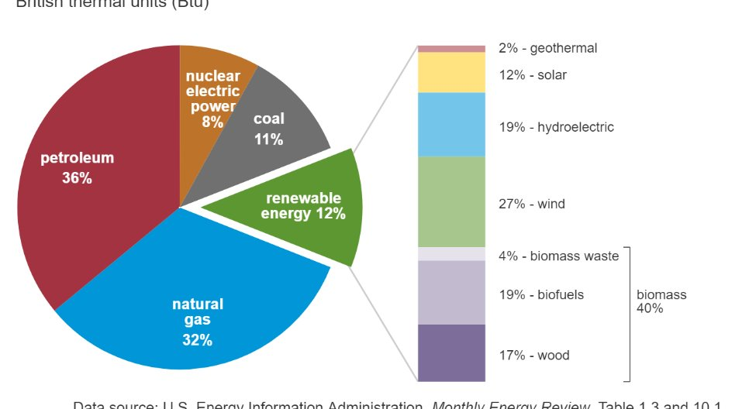
Figure 1
Figure 3
Figure 2

Slide 8

Idea - Social Media Campaign
Social media would be the best medium to advertise this campaign.
People are more likely to speak their mind on social media and be influenced.
The AI could respond to comments and change its attitude according to the person.
AI would decrease costs of having someone run a campaign themselves

Slide 9

Conclusion
Impact and Scalability:
An AI like this can be used to advocate for other causes, like climate change, plastic pollution bans, and saving endangered animals.
The persuasive nature of the AI can be used to advertise products of a company.
AI can cut costs by reducing the need for workers.
Overall, using AI to campaign for something like nuclear power can have a great impact in changing the views of many people.

Slide 10
Sources
Understanding nuclear fuel recycling | Orano
Fukushima Daiichi Accident - World Nuclear Association
More Power per Punch: Nuclear Energy Outshines Fossil Fuels

